Slide 1
Final Mini Project B By: Shruthika Ilavarasu, Team 5

Slide 2
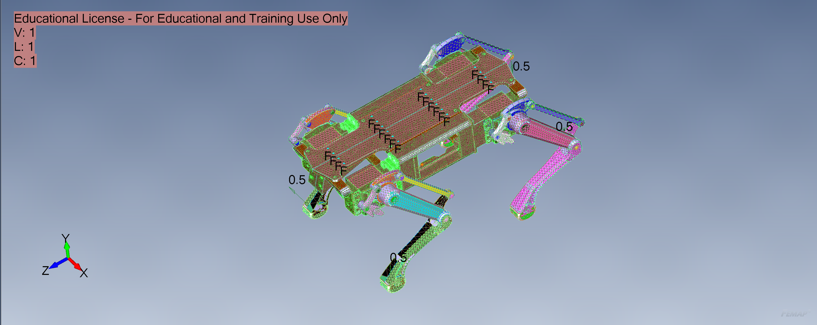
Final CAD with Applied BC’s and Loads
Constrained Frame

Slide 3
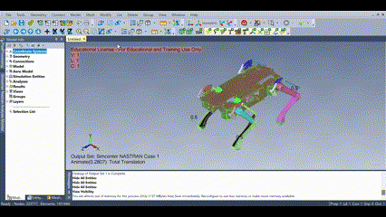
Animation of Deformation

Slide 4
Assumptions: Material Properties & BC’s
Young’s Modulous & Poisson’s Ratio: | Density: | Boundary Condition: | Applied Loads | Joints:
70 Gpa v=0.3 | 2.7 g/cm^3 | Fixed at Top Frame | Fx=0.5N Fy=0.5N Fz=0.5N | Joined with RBE and Spring with rotation about X-axis

Slide 5
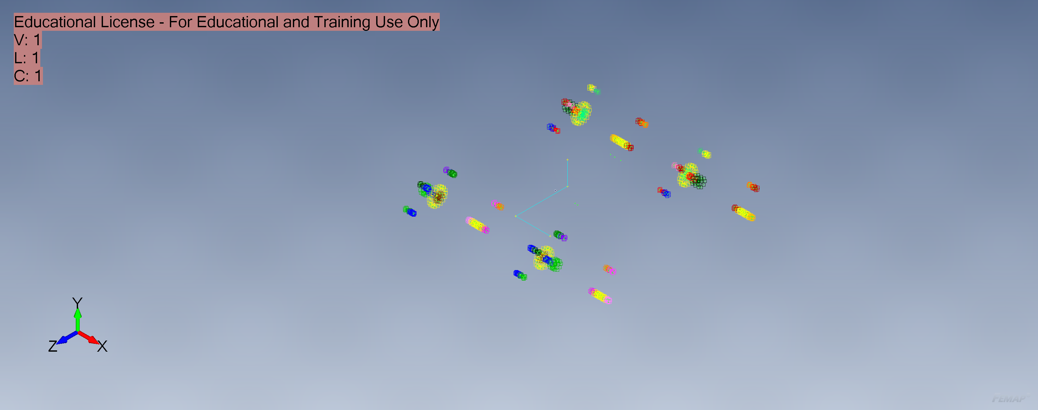
All Joints Present In Model

Slide 6
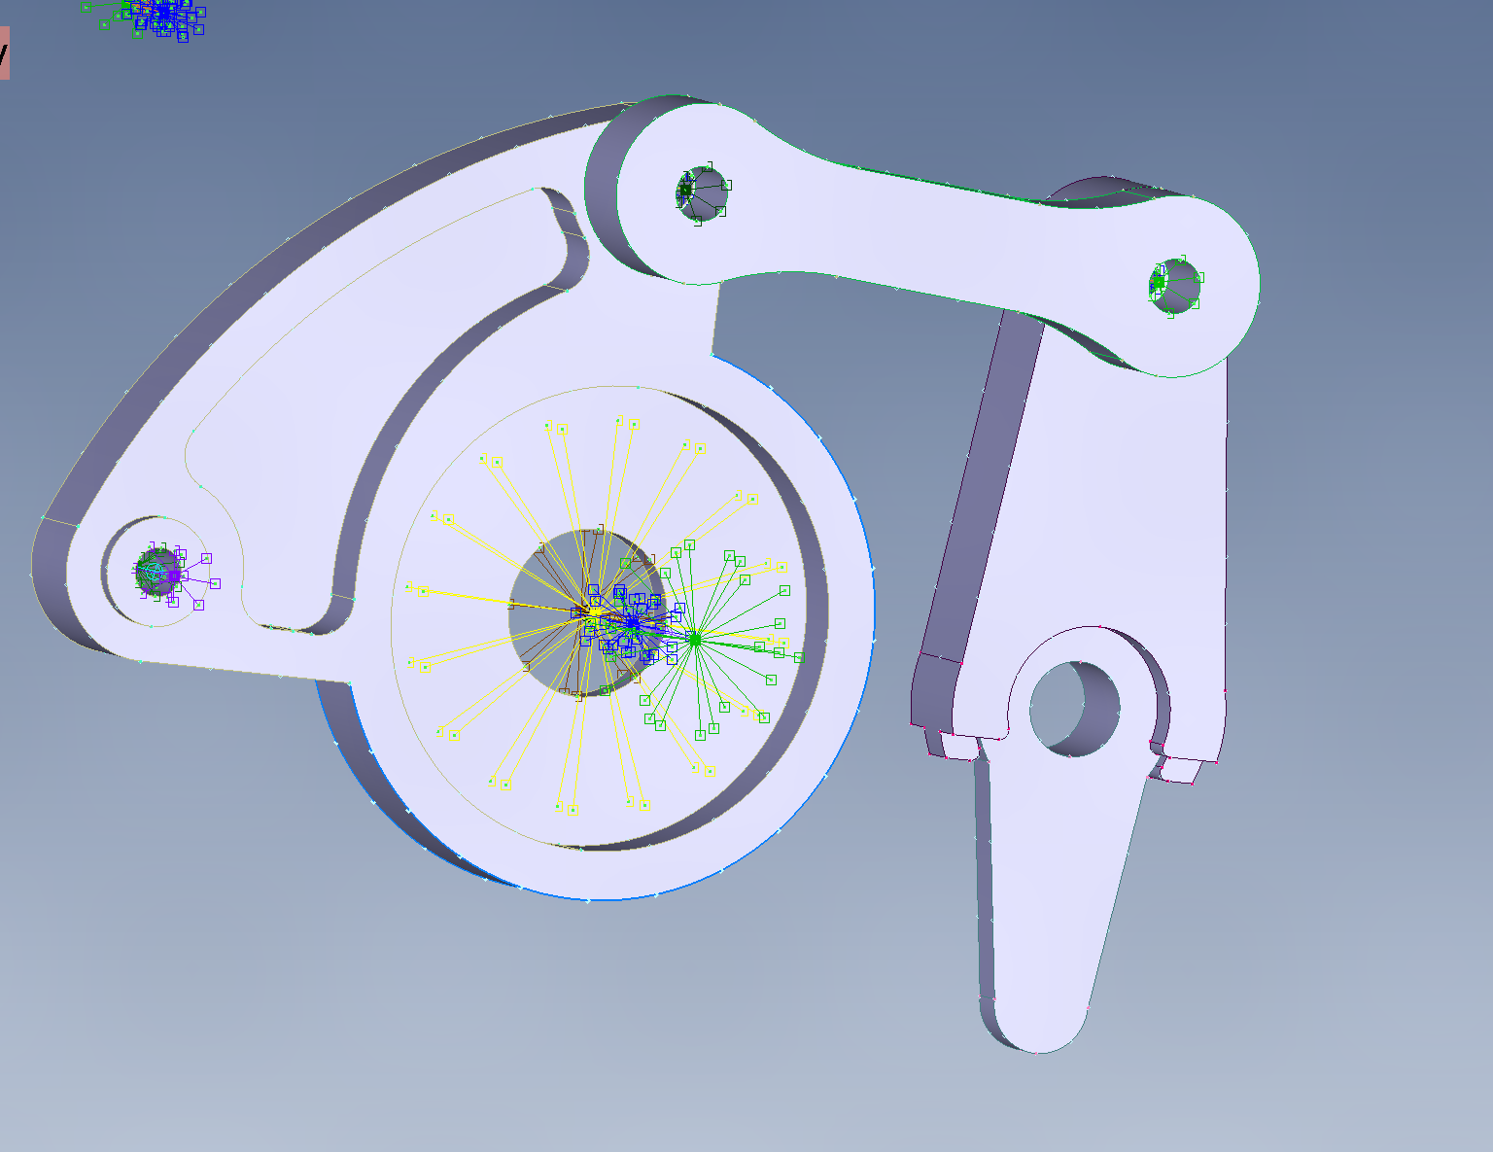
Joint Types:
Leg Servo Joints
On all Four Legs

Slide 7
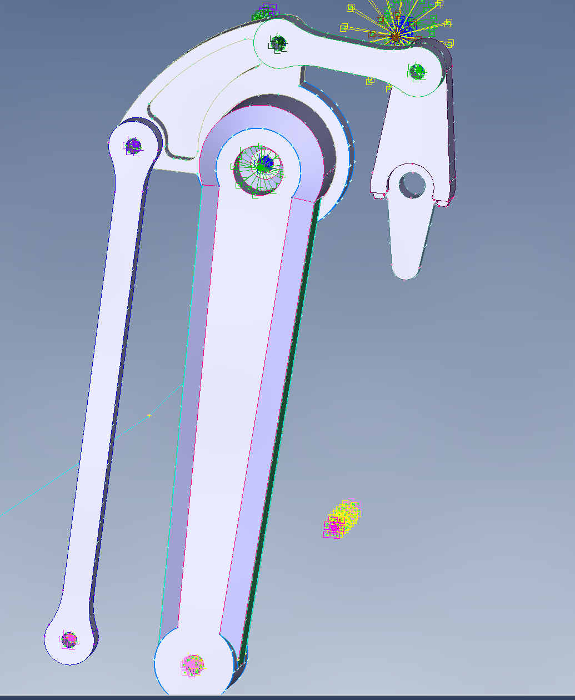
Joint Types:
Leg Joints to Servo Motors
On all Four Legs

Slide 8
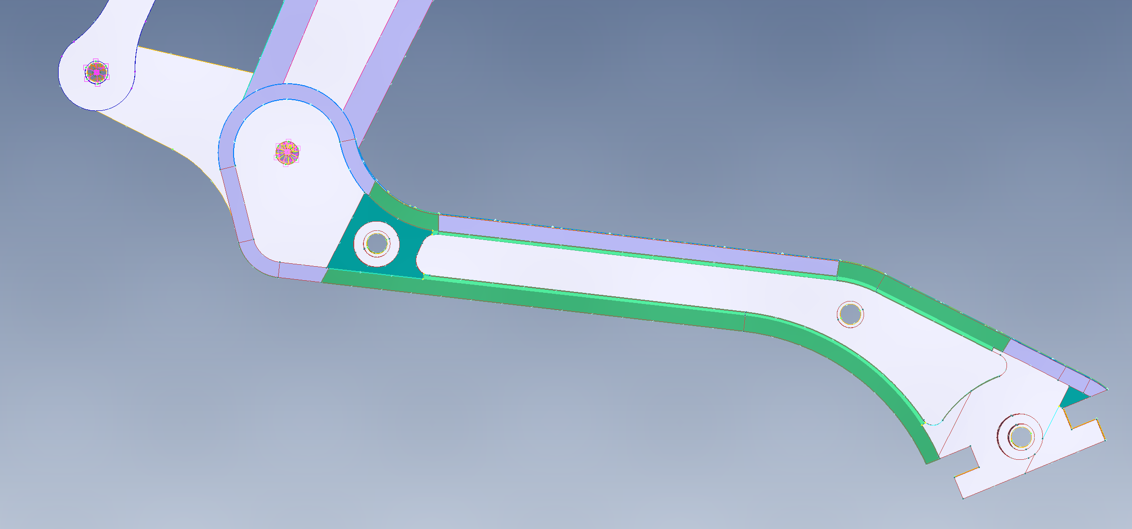
Joint Types:
Bottom Leg Joints to the Top
On all Four Legs

Slide 9
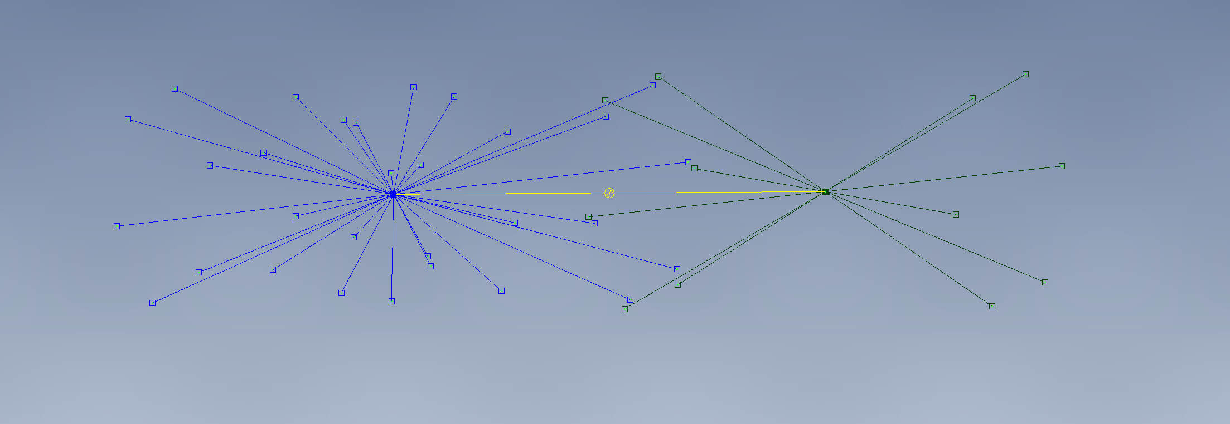
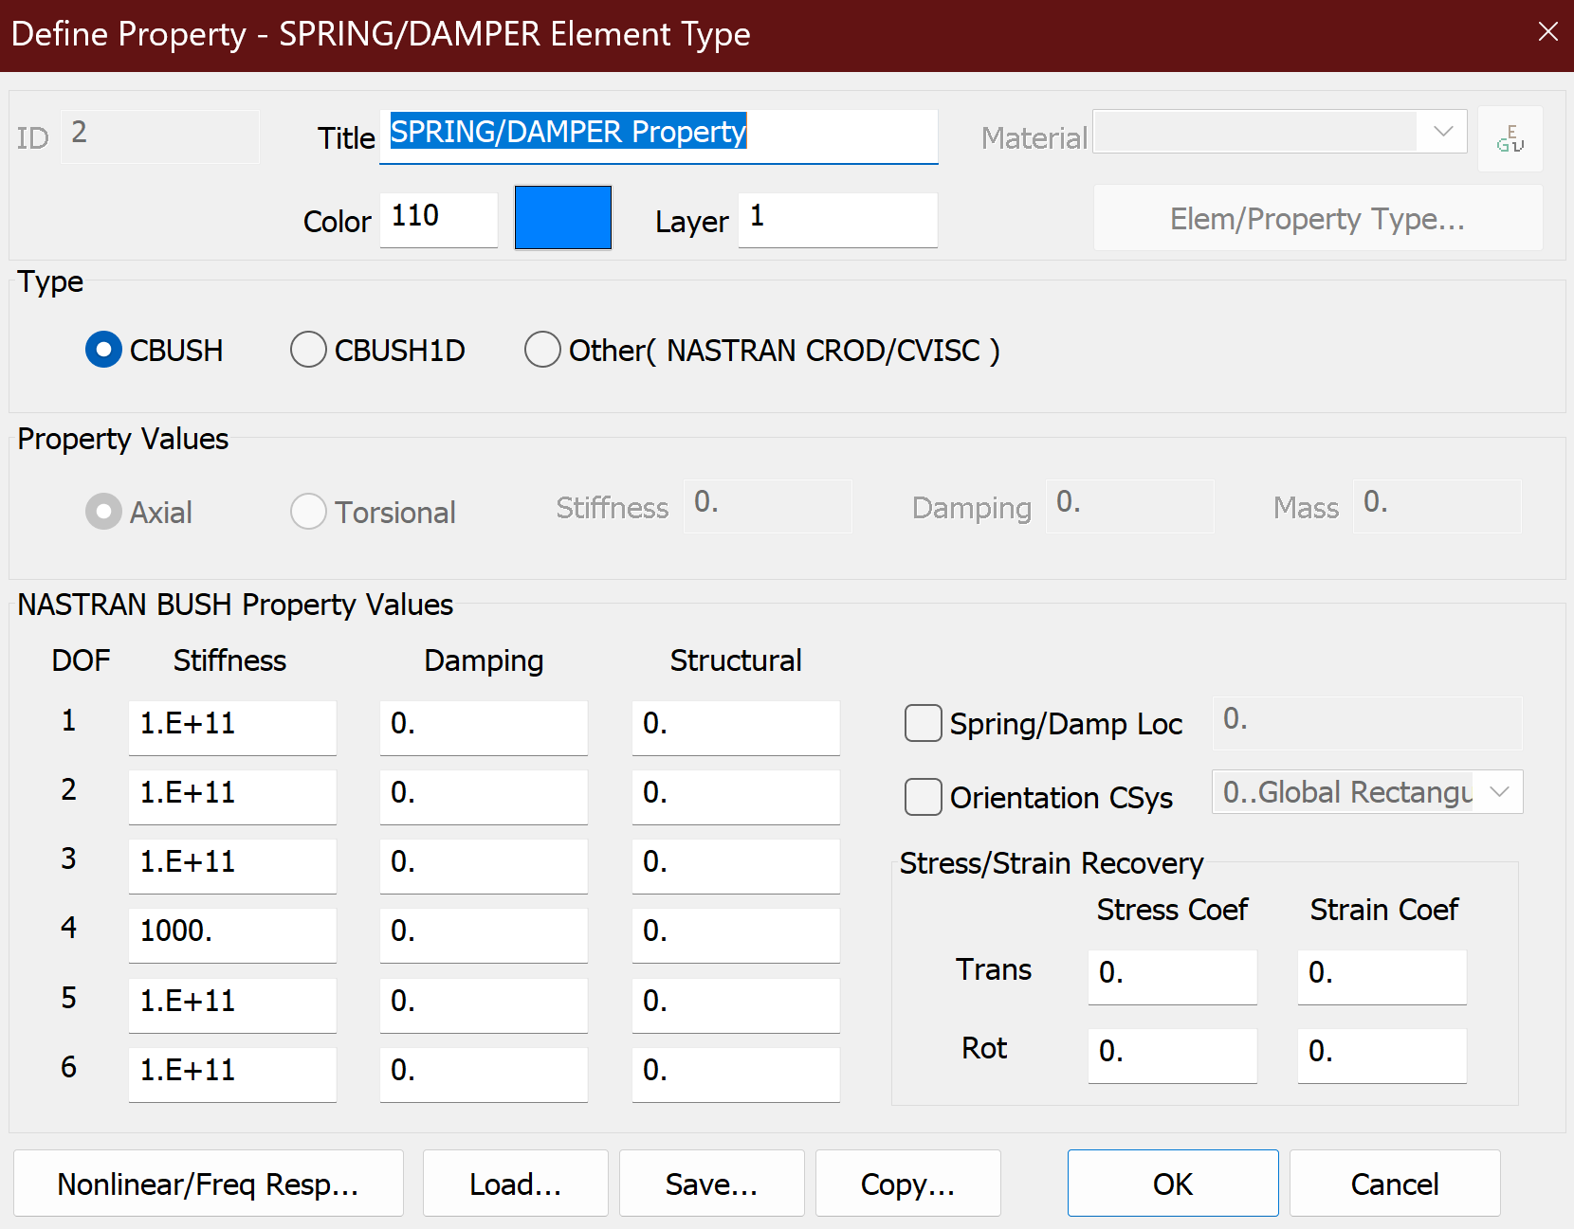
Joints Applied
Rigid Body Element
Rigid Body Element
Spring Element with Rot
about X-axis

Slide 10
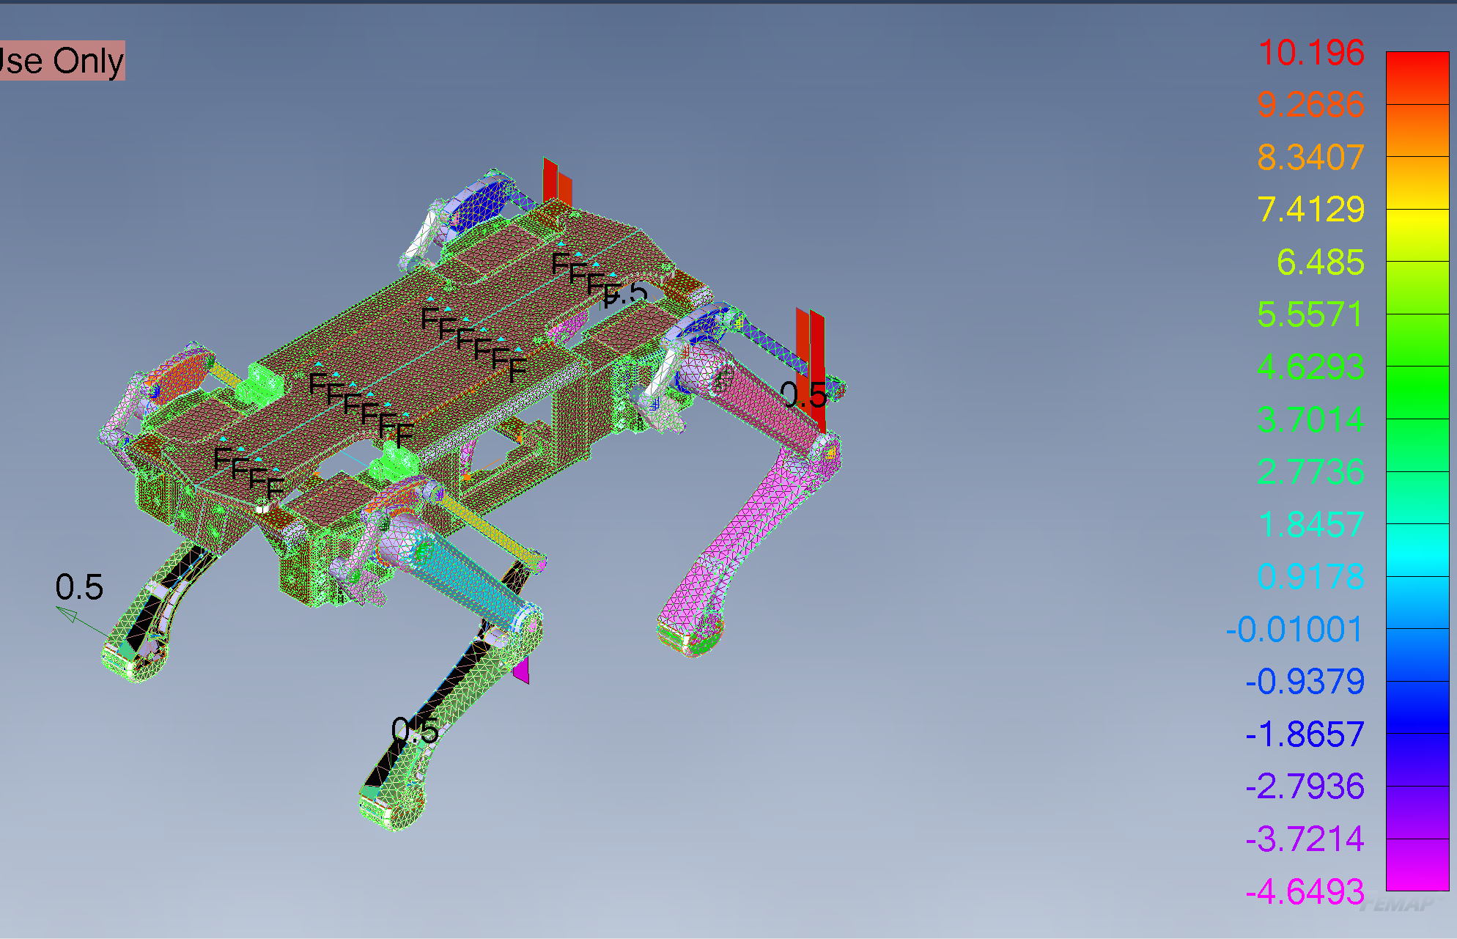
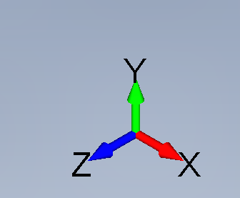
Analysis: Joint Loads
Analyzed using Bush Force for Spring Elements inside Joints
Experienced most loads at the knee joints of the legs
Experiences minute contractions on the Hinges connecting the legs to the servo motors.
Experiences more contraction when the load is applied on the foot of the robot.
Experiences no load when it is applied in the X-direction of the foot.

Slide 11
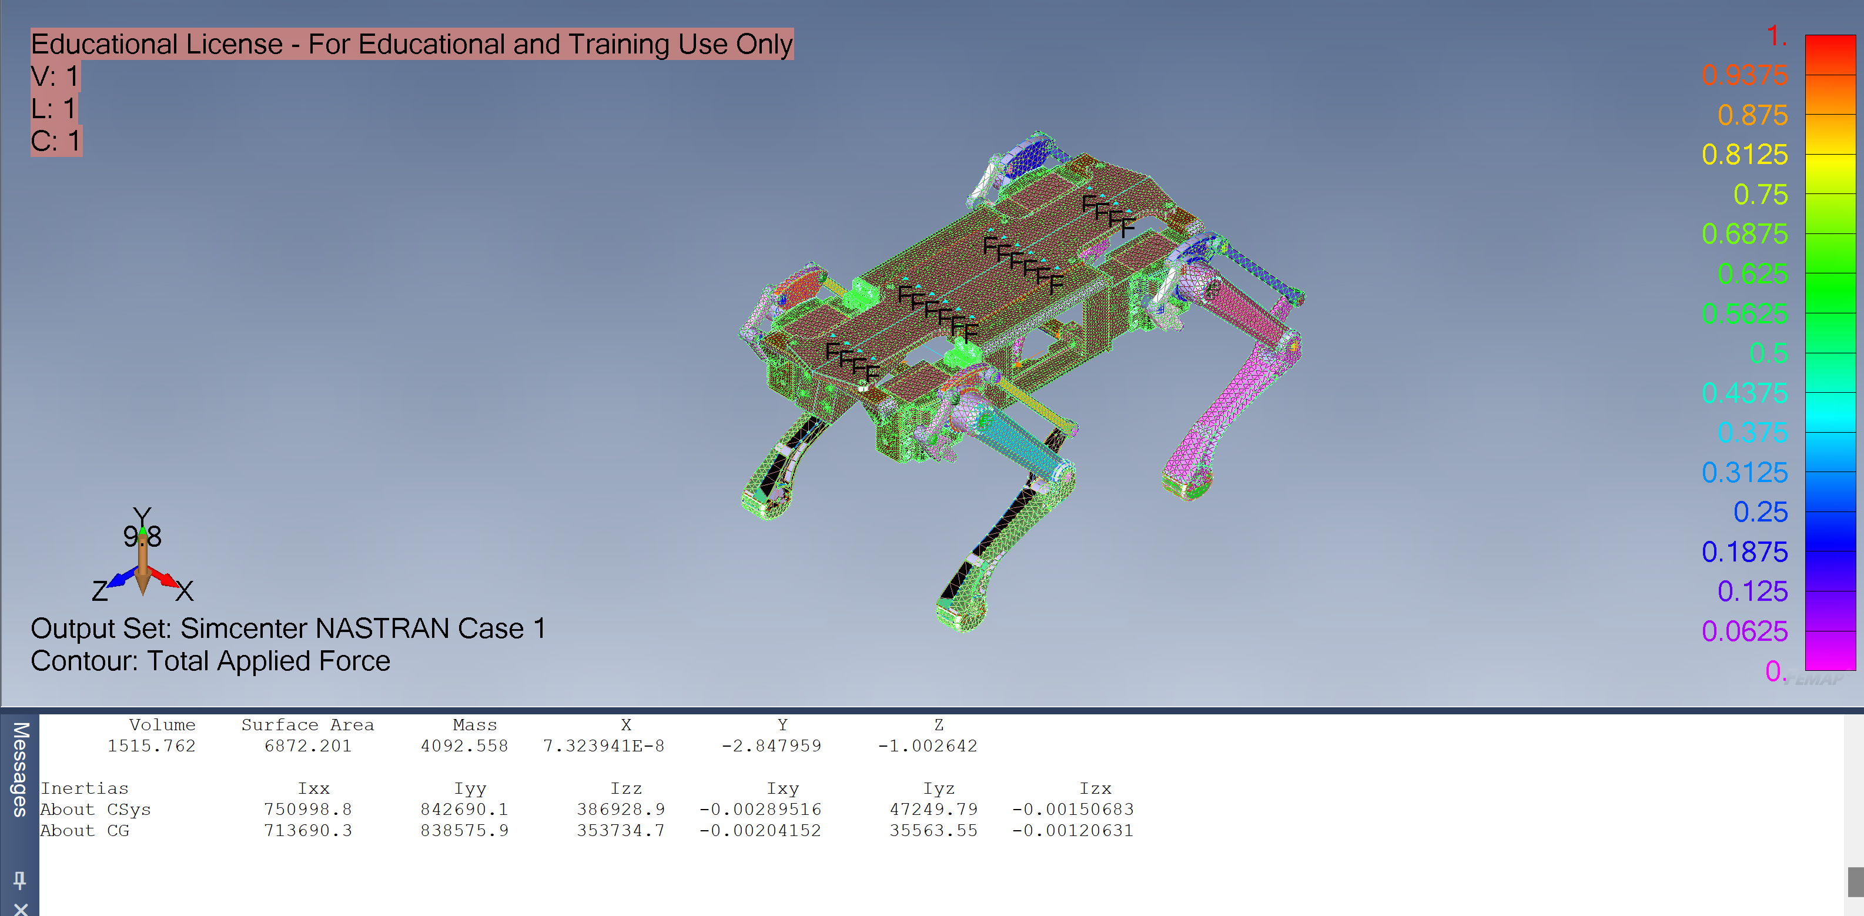
Analysis: System Weight, Method 1
Taking off all forces on the joints but keeping the Robot Fixed on Top of the Frame
Apply a Body Force as a Gravity of -9.8 in the Y-direction
To check mass of system: Go to Tools>>Mass Properties>>SolidProperties; and apply the solid density (aluminum)
Weight=MassxGravity
W=9.8*4092.558= 40,107 N

Slide 12
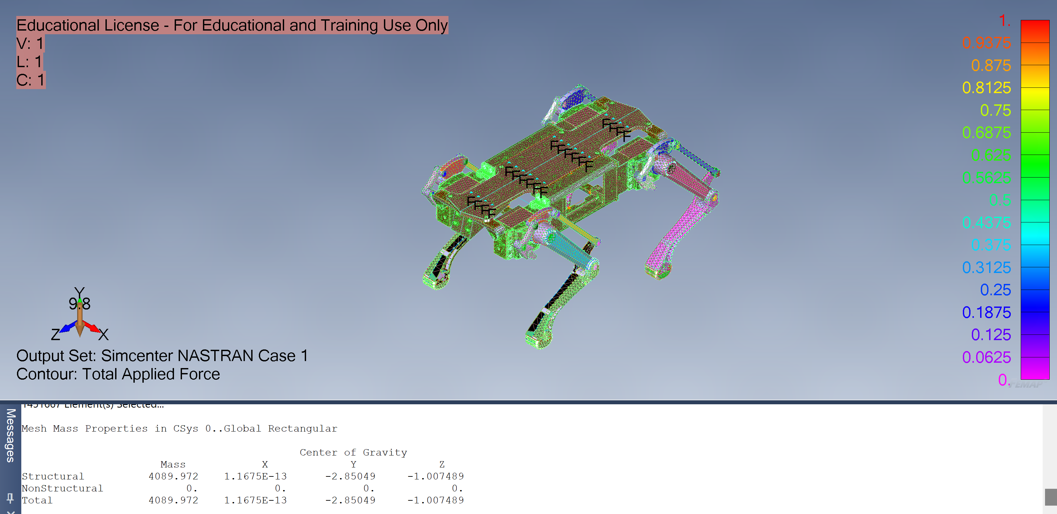
Analysis: System Weight Method 2
I do the same procedure
When checking for mass, go to Tools>> MassProperties>> MeshProperties; to find the mass of the mesh
W= 9.8*4089.972=40,081.7 N

Slide 13
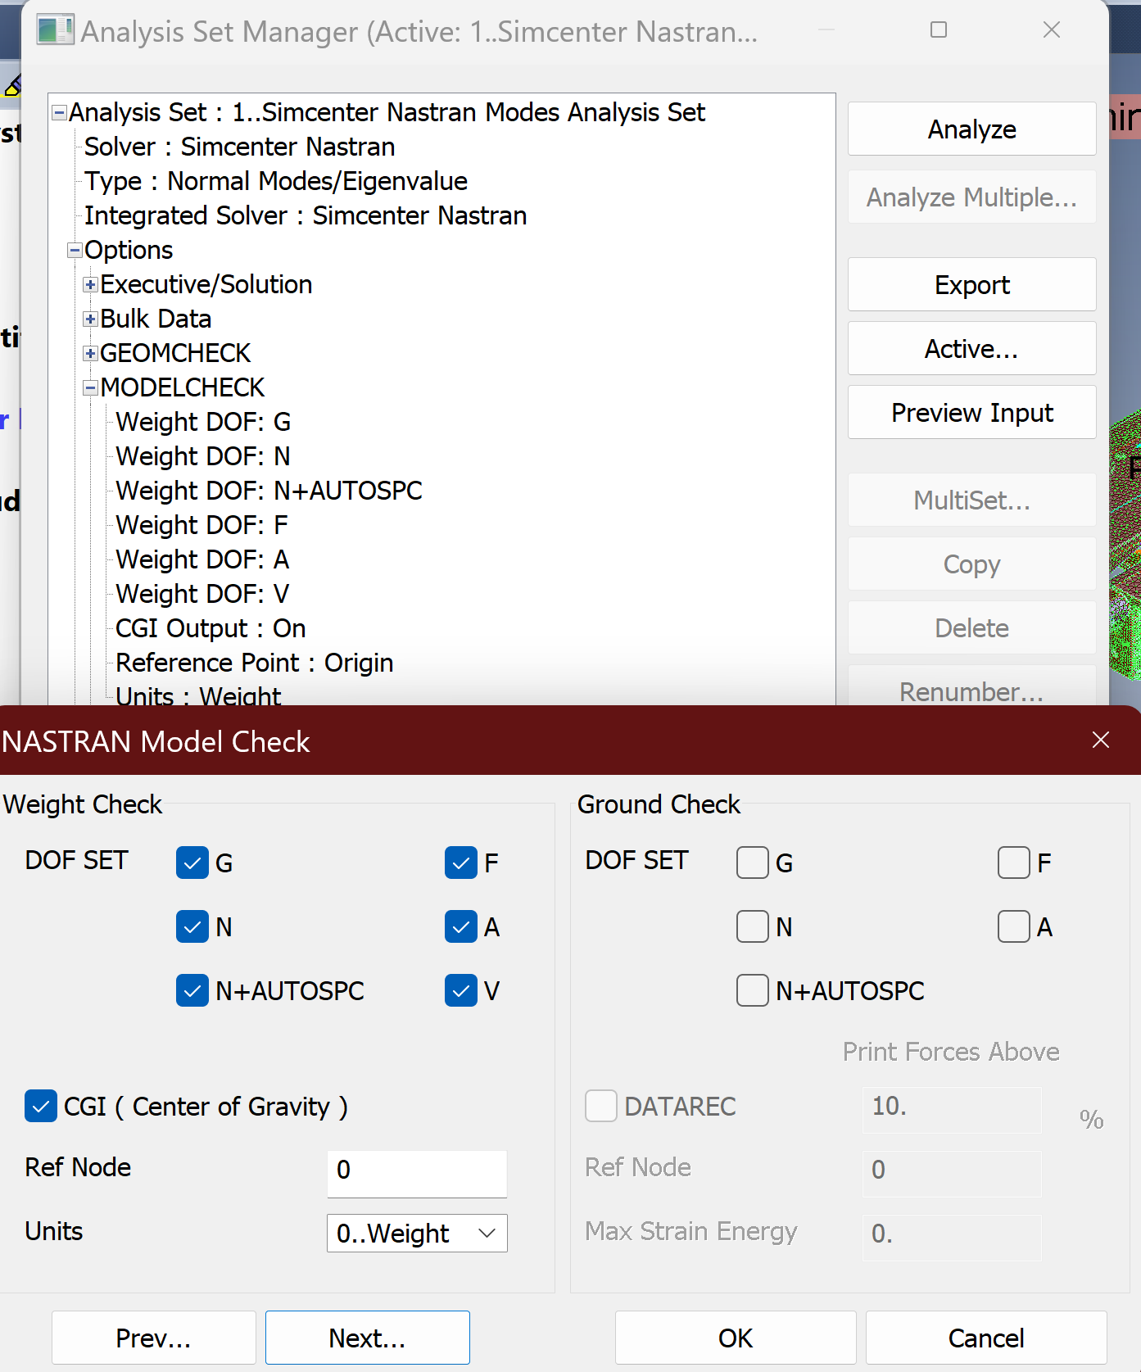
Analysis: System Weight Method 3
NASTRAN WEIGHTCHECK
Notes:
When creating analysis: Analysis>>New
Analysis Type: Normal/Eigenvalues
Expand:
Options>>MODELCHECK>Edit>>check all DOF>>check CGI
Master Requests and Conditions>>Output Requests>Edit>>Results and Destination>>Print and PostProcess
Weight should come in .f06 file

Slide 14
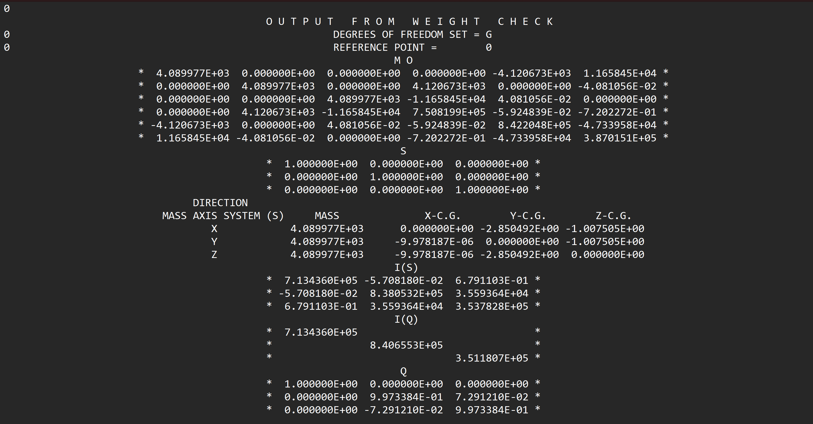

Slide 15
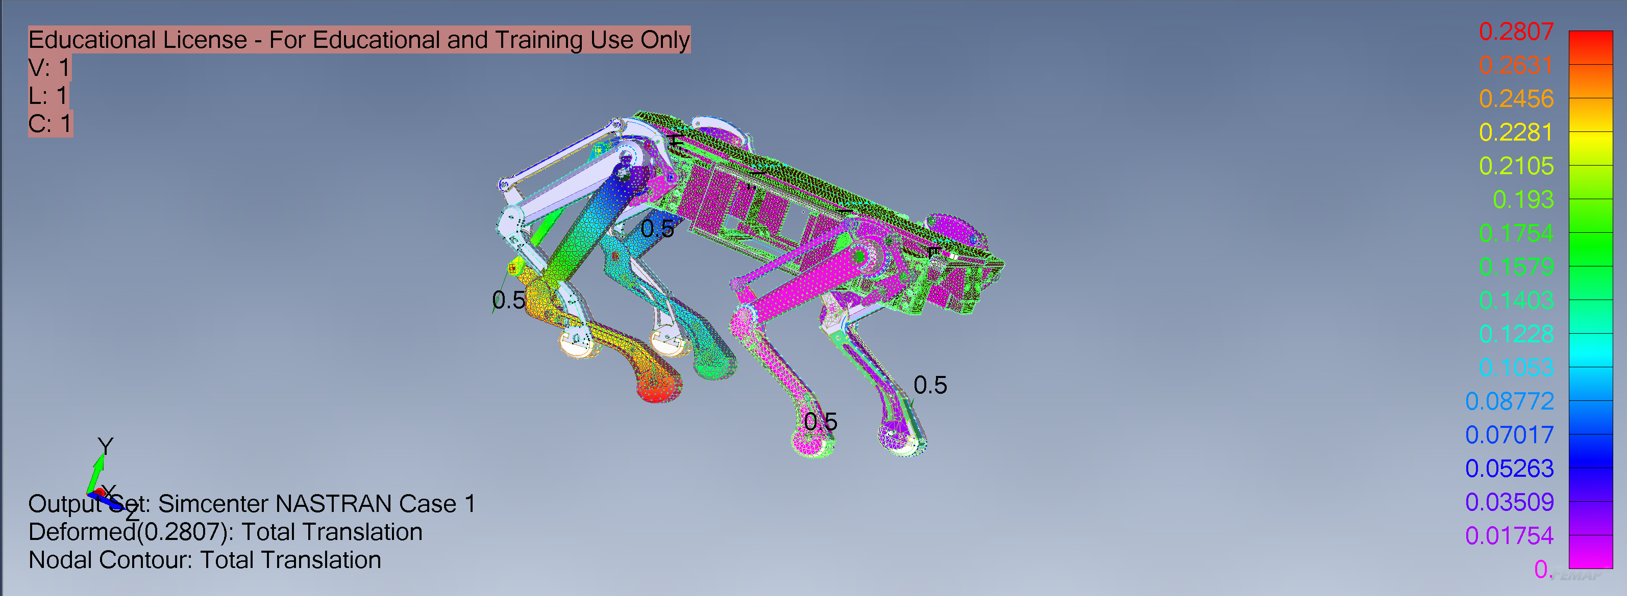
Max Displacement
Occurs in the Z-Direction
0.2807 cm

Slide 16
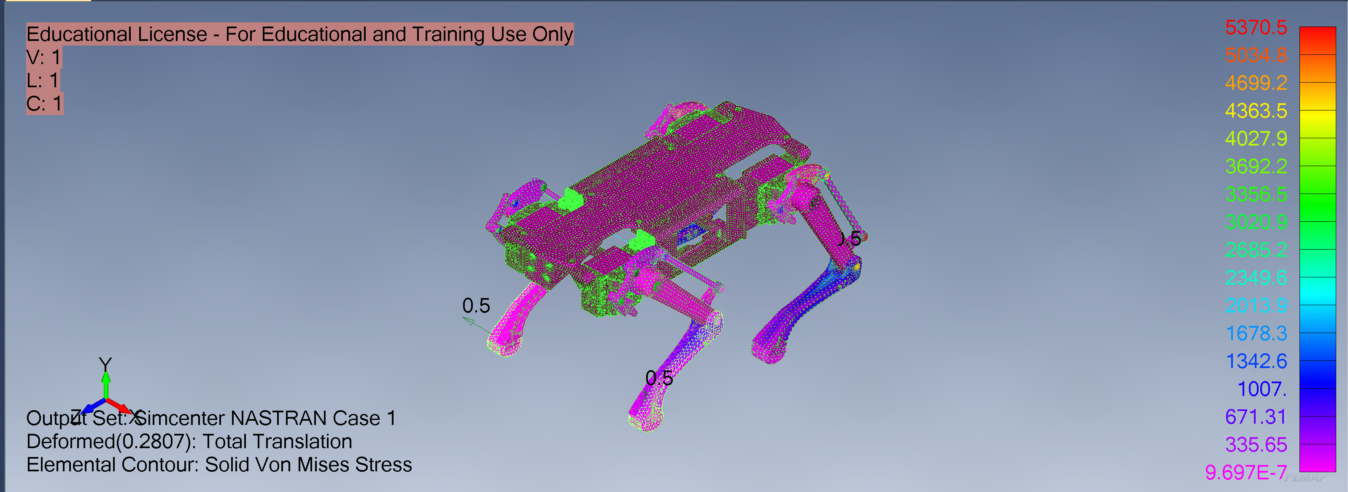
Max Von Misses Stress
Occurs inside Joints

Slide 17
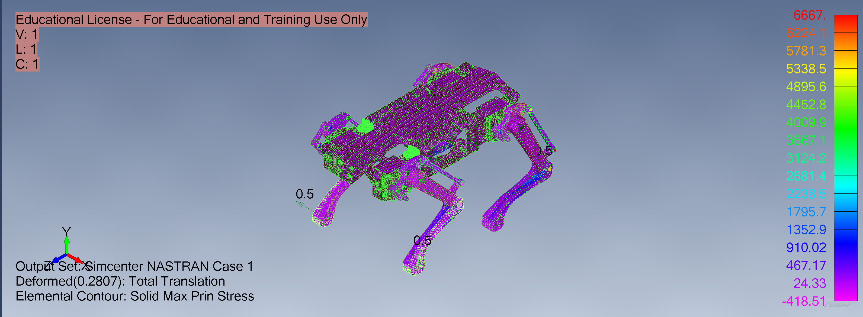
Max Principal Stress
Occurs inside Joints

